Slide 1


Slide 2
Group Members
Pranshu Pranjal 16BIT0044
Ekansh Gayakwad 16BIT0133
Manas Dange 16BIT0162

Slide 3
Introduction
VITTERSTOCK is a medium which allows a user to share images with other users, and users can download images shared by others users.
The images are categorised in different categories like genres, scenery, landscape, landmark, location, trending or old etc.
It will also contain a favourite section where user can add images and it will showcase a trending image at the starting of the day.
Users will be able add filters to the images and rate them as per their viewpoint.

Slide 4
Objective Analysis
This will allow people to flaunt their photographic skills and will provide a potential platform for budding photographers.
It will also be useful for flaunting the beauty of VIT Campus and will attract attention of freshers.
Moreover, the project would be a famous platform for photography club which could host competitions and scourge hidden talents.

Slide 5
Basic Layout
On typing our website address, the landing page will be our login or sign up page; after which it will take to the home page.
The homepage will contain carousel which will show picture of the day, some trending pictures. The home page will contain navbar (fixed at top) to navigate to different pages. Also the main genres of photos will be shown as photo grid in home page.
The normal page containing will show photos arranged using bootstrap grid system and each photo will have tags attached to it for easy searching

Slide 6
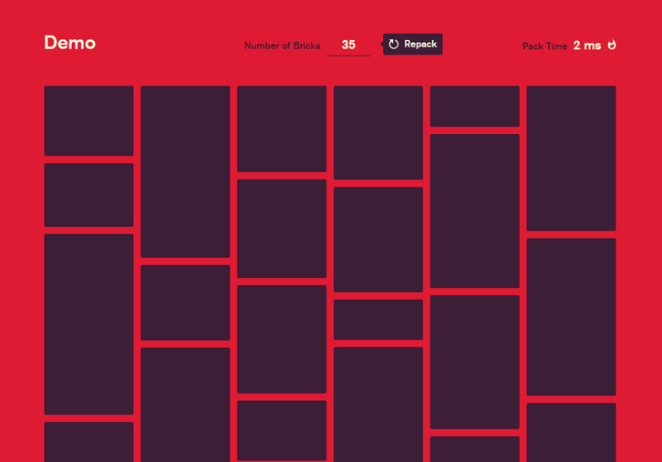


Inspiration modules
Particle.js
Masonry.js
Brick.js
Carousel
Crystallization

Slide 7


